Slide 1




ImpactDash
How to measure your success?

Slide 2

code for impact
Deborah Haar
Michael Huber
Anne Estoppey
Viktoria Mayer
Mirela Christescu
Notes:
-have you ever been at an event that you enjoyed you knew was a very valuable experience?
But if someone asks you, what do you say, how do you measure that?
-the current solutions are costly, dont address the diversity in tech

Slide 3
problem to solve
lack of tailored metrics
difficulties in collecting the necessary data
analyze and visualize data in a meaningful way
support decision-making with data and information
Notes:
-have you ever been at an event that you enjoyed you knew was a very valuable experience?
But if someone asks you, what do you say, how do you measure that?
-the current solutions are costly, dont address the diversity in tech

Slide 4
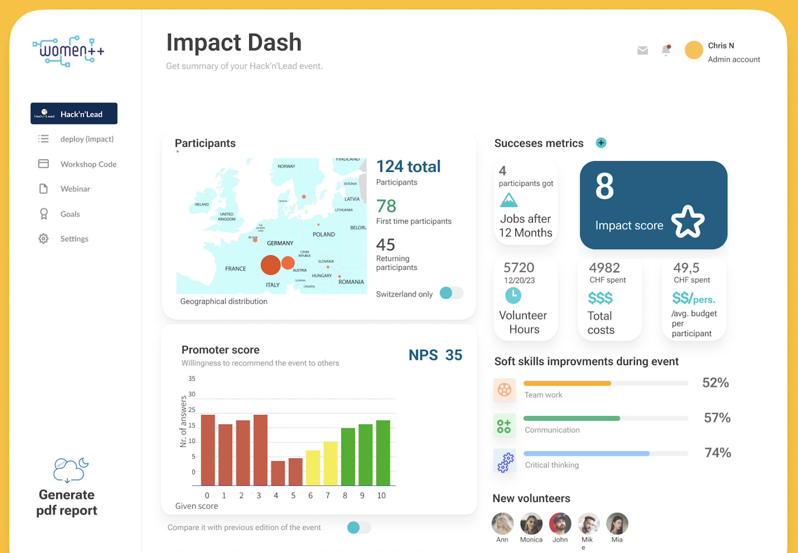
solution

Slide 5
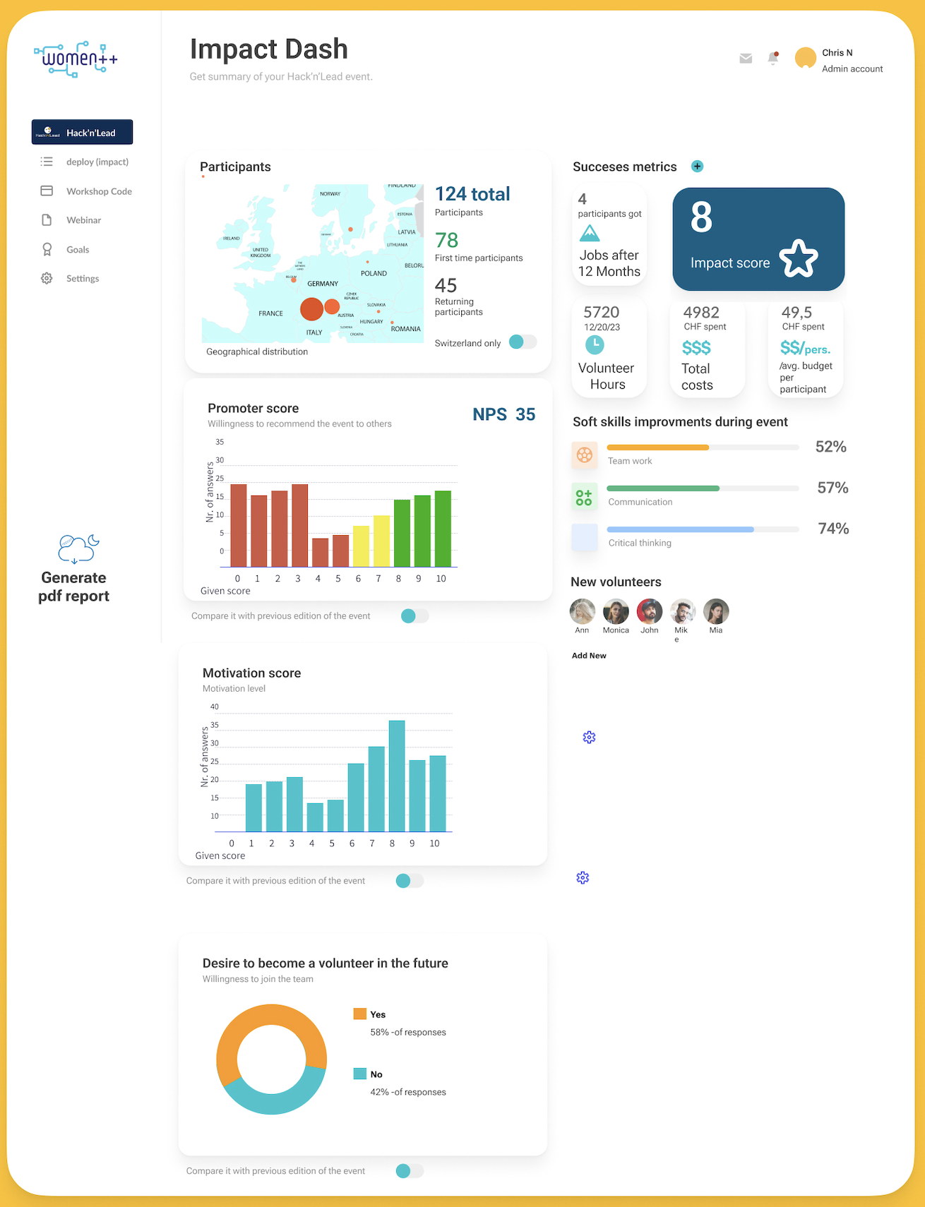
solution

Slide 6
Thank you!
◤

